Slide 1
Propaganda: A Most Effective Tool How To Involve Students Through Multiple Media
Will Kelley
Kirby High School

Slide 2
Session Norms
Be present and engaged
Be respectful of differences in perspective while challenging each other productively and respectively
Monitor “air time”
Make the most of the time we have
Stay focused on students

Slide 3
Objective
Technology and Social Studies/Teaching with Primary Source Documents
Know: Recent developments have created new opportunities for powerful social studies teaching assisted by technology. Computers are much more powerful and versatile than they were a decade ago. Teachers can develop lessons that enhance student skills in information retrieval, the presentation of data, the comparison and evaluation of different perspectives, analyzing and documents and resources, and critical reflection and decision making. Our purpose in this article is to identify the key considerations that should influence the selection of instructional technology in order to assist educators to evaluate current products and assess the feasibility of their use in the classroom.
Understand: Students can be taught to comprehend and analyze informational text features using a variety of Internet sources. Teachers should also understand that successful use of technology in the classroom requires careful planning, informed choices of hardware and software, and the matching of educational programs to curricular objectives and student abilities.
Do: Teachers should leave the session experienced in using the internet as a resource to find appropriate primary and secondary sources, texts and text features to teach literacy strategies that enable students to comprehend information. Teachers should also be able to access websites that can be used as a resource for teaching and use activities that engage students in higher levels of Social Studies learning.

Slide 4
Do Now
Think about the last media message you saw that grabbed your attention, affecting your worldview and your thought process. What was it? Why did it affect you so? Discuss this with your neighbors?
Above & Beyond: Compare & contrast advertising in general 20 years ago with advertising today. What is similar? What is different? Discuss this with your neighbors.

Slide 5
Propaganda
Propaganda- the spreading of ideas, information, or rumor for the purpose of helping or injuring an institution, a cause, or a person (Merriam-Webster Online)
Propaganda=advertising
Advances causes
Spreads a message
Everyday examples of propaganda?

Slide 6
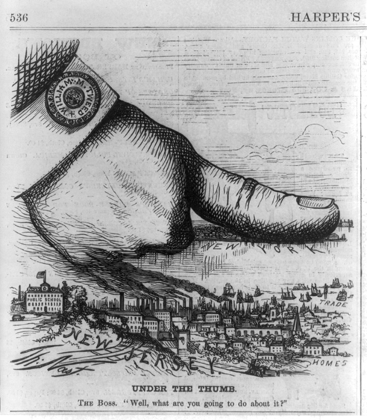
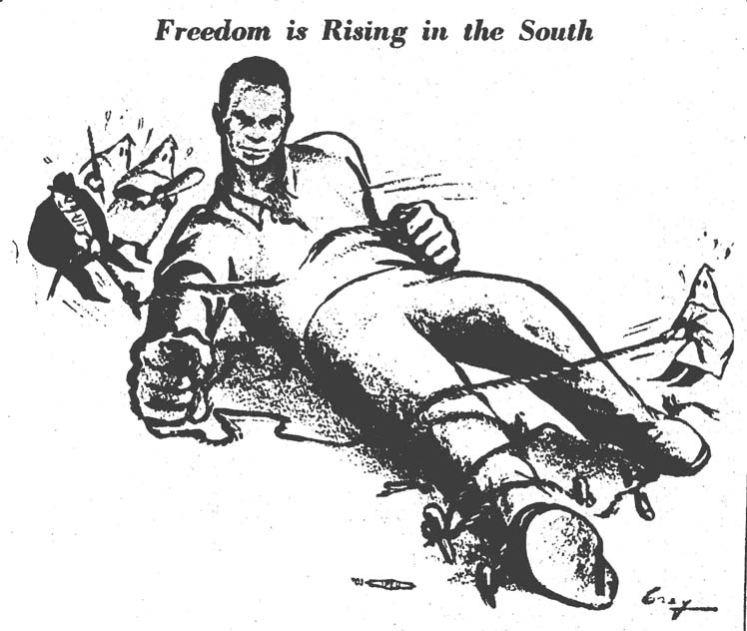
Propaganda

Slide 7
Propaganda Characteristics
Specific color patterns
Use of bold/ over the top images
Short & bold verbal messages
?????

Slide 8
Why Propaganda?
Learn to recognize new forms of propaganda in everyday life
Practice skills of interpretation and critical analysis
Consider how context shapes the way messages are understood
Reflect on diverse interpretations of media messages in ways that promote understanding of and respect for others’ perspectives
Shift from passive receivers to critically engaged participants in global public discourse
(source: National Holocaust Museum)

Slide 9
Where Can I Find It???
Library of Congress Website (www.loc.gov)
TN State Library & Archives (http://sos.tn.gov/tsla)
Edugoodies (http://www.edugoodies.com)
YouTube-lots of cartoons and movie clips (www.youtube.com)
Google image search (www.google.com)

Slide 10
Standards To Use
SSP 1-5 Very crucial!
6.11 Identify important achievements of the Mesopotamian civilization, including cuneiform, clay tablets, and ziggurats, and identify the Epic of Gilgamesh as the oldest written epic.
6.18 Analyze the achievements of ancient Egyptian civilization, including: hieroglyphics, papyrus, and the pyramids and Sphinx at Giza.
7.25 Explain the importance of griots in the transmission of West African history and culture.
7.44 Analyze Johannes Gutenberg’s printing press and William Tyndale’s translation of the Bible into the English language as vehicles for the spread of books, growth of literacy, and dissemination of knowledge.
8.16 Explain the historical purposes and consequences of Thomas Paine's Common Sense.
CI.19 Analyze the changing role of media and technology on the spread of information and the effects on global culture.
US.55 Describe the war’s impact on the home front, including: • Rationing • Bracero program • Bond drives • Conversion of factories for wartime • Propaganda production • Movement to cities and industrial • Location of prisoner of war camps in centers Tennessee
W.42 Compare and contrast the rise to power, goals, and characteristics of Adolf Hitler, Benito Mussolini, and Joseph Stalin’s totalitarian regimes.
GC.33 Describe the role of the media as a means of communicating information and how it influences the importance of issues and public opinion.
E.50 Evaluate the arguments for and against free trade.
SDCAH 13f. Discuss the impact of war mobilization on the economy and society.
SDCWH 25c. Explain how global social, political, and technological trends have shaped contemporary life

Slide 11
Propaganda Cartoon
https://www.youtube.com/watch?v=HeTqKKCm3Tg
Due to file size limitations, I’m inserting the link to the cartoon from the session. Please feel free to insert your own.

Slide 13
Propaganda Activity US.55 Describe the war’s impact on the home front, including: • Rationing • Bracero program • Bond drives • Conversion of factories for wartime • Propaganda production • Movement to cities and industrial • Location of prisoner of war camps in centers Tennessee SDCAH 13f. Discuss the impact of war mobilization on the economy and society.
Each group will create a piece of drawn propaganda & accompanying paragraph
The piece will have an artistic rendering of your message, as well as a catchphrase covering your message
Categories: fuel or food conservation, war bonds, enlistment, help with war effort, women/ minority roles, national security
Accompanying paragraph: minimum 5 sentences describing what your propaganda piece is trying to convey. How it does that? How would this fit in World War II? How does your piece illustrate life on the U.S. home front during WWII? Everyone MUST write the answer to at least ONE of the questions on 1 sheet of paper.
For those that finish early, compare & contrast the Rosie the Riveter & Uncle Sam posters. Examine the messages they present. What is similar? What is different?
After time is up, we will conduct a gallery walk of all propaganda.

Slide 14
Other Activities
Build A House/3 Questions-Image activity where an image is shown, and students answer the questions “What do you physically see in the image?”, “ What are your first impressions?”, and “ What message is sent by this image?”
Ad campaign-students can create their own advertisement based off of rhetoric from speeches and writings.
Social Media Activity-Twitter: students can either live tweet a historical event, or create a series of “promoted Tweets” using a propaganda campaign from the past; Facebook: status updates from the past/historical leaders; Instagram: historical images or scenes.
Puzzle-image activity where images can be cut into pieces and numbered on the back, mixed up and put into an envelope, then pulled out one at a time, with students making educated guesses after each piece is revealed.
Extended Response Essay-students are given an image or text excerpt and will write a multiple paragraph essay answering critical thinking questions about the item.

Slide 15
Exit Ticket
Write down:
-1 thing you really took away from today’s presentation
-1 way you plan on using this in your classroom
-1 thing you need explained to you in more depth and detail.
Also, any and all feedback is welcome!!! Contact me:
Will Kelley
KELLEYW@scsk12.org
teacherwillkelley.weebly.com

