Slide 1
Washington vs. DuBois
Differing Viewpoints, Differing Actions
Will Kelley-Kirby High School, Shelby County (TN) Schools
teacherwillkelley.weebly.com

Slide 2
Objective: Engage in a social media activity that improves historical and social studies literacy, while engaging the students in a part of their culture and interests.
Standard: ALEX US History II-2.) Evaluate social and political origins, accomplishments, and limitations of Progressivism. [A.1.a., A.1.b., A.1.c., A.1.d., A.1.e., A.1.f., A.1.i., A.1.k.]
Essential Question: How did Booker T. Washington & W.E.B. DuBois differ in their approached to education, and how did these differences meet the needs of African-Americans during the Jim Crow Era?

Slide 3
Post-Reconstruction African American Education
-Prior to the Civil War, little to no effort had been given to African-American education. Some states had laws making it illegal for African-Americans to be taught how to read.
-After the Civil War, the Freedmen’s Bureau began teaching former slaves basic education; however, Reconstruction ended after the Corrupt Bargain of 1876/77; Federal troops were pulled out of the South, and African-Americans were disenfranchised by the government.
-It was up to African-American educators to lead the call for African-American education.

Slide 4
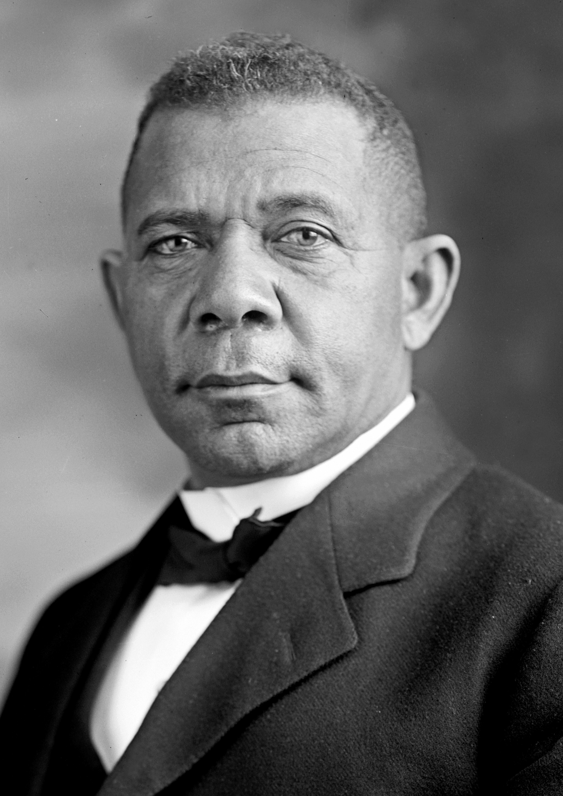
Booker T. Washington (1856-1915)
-Born a slave in southwestern Virginia
-Started learning how to read after being emancipated at age 9
-Put himself through the Hampton Institute (now Hampton University) by working in the salt furnaces and coal mines of West Virginia
-Recommended to become the first president of the Tuskegee Institute in 1881 at age 25
-Spent the remainder of his life working at Tuskegee and trying to further education for African Americans
-Became very influential in white circles and developed multiple wealthy white patrons to support Tuskegee Institute, including John D. Rockefeller, Andrew Carnegie, and William Howard Taft.
Success is to be measured not so much by the position that one has reached in life as by the obstacles which he has overcome.
-Booker T. Washington

Slide 5
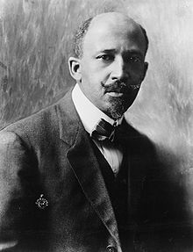
W.E.B. DuBois (1868-1963)
-Born after the Civil War in Great Barrington, MA
-Educated at Fisk University, the University of Berlin, and Harvard University, where he was the first African-American to earn a doctorate
-Held multiple positions in academia (mostly at Atlanta University), edited the NAACP magazine The Crisis, wrote multiple books, and delivered multiple speeches and presentations
-Bounced back and forth between academia and the NAACP on multiple occasions
-A major player in the Pan-Africanism movement; organized many Pan-African conferences and congresses
-Became disillusioned with American society and displayed socialist tendencies during the last 3 decades of life
-After an accusation of Communism during the Red Scare, spent the last 2 years of his life in Ghana, working on the Encyclopedia Africana
Education must not simply teach work - it must teach Life.
-W.E.B. DuBois

Slide 6
DuBois v. Washington
-The division and animus was mostly between the followers of Washington & DuBois; the two men disagreed with one another, but according to DuBois, much of the friction came from and between their followers.
-Nevertheless, the differing viewpoints of both men drew lines in the sand between those that believed economic equality must be earned by African-Americans before social equality could be given by whites (Washington), and those that believed social equality must be freely given by whites so that African-Americans as a whole could gain economic equality (DuBois)
-Battle lines appeared in multiple newspapers and magazines throughout the early 20th century

Slide 7
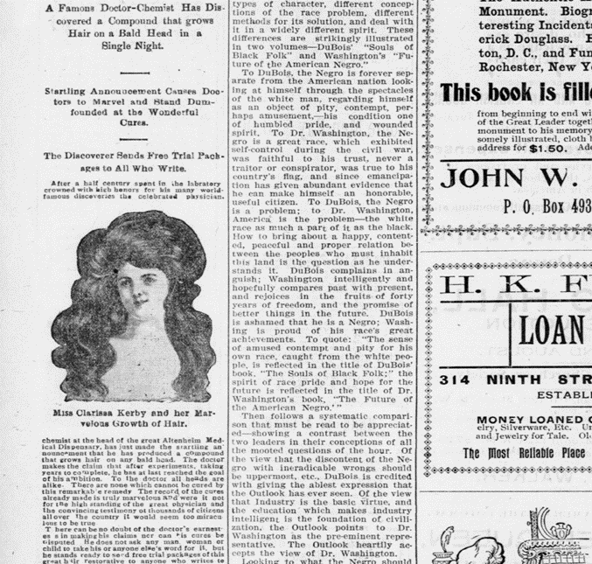
A pro-Washington Example
The (Washington, D.C.) Colored American, July 4, 1903, pg. 14 (Originally published in The (New York) Outlook*, May 23, 1903)
“To DuBois, the Negro is forever separate from the American nation looking at himself through the spectacles of the white man, regarding himself as an object of pity, contempt, perhaps amusement-his condition one of humbled pride, and wounded spirit. To Dr. Washington, the Negro is a great race, which exhibited self-control during the civil war, was faithful to his trust, never a traitor or conspirator, was true to his country’s flag, and since emancipation has given abundant evidence that he can make himself an honorable, useful citizen. To DuBois, the Negro is a problem; to Dr. Washington, America is the problem-the white race as much a part of it as the black race.”
* It must be noted that The Outlook serialized parts of Washington’s autobiography Up From Slavery, and The Colored American would be purchased by Washington the next year.

Slide 8
Annotation Guide
During reading:
• Underline the major points.
• Use a question mark (?) for keywords or phrases that are confusing or unknown to you or question that you have during the reading. Be sure to
write your question(s).
• Use an exclamation mark (!) for things that surprise you, and briefly note what it was that caught your attention.
• Draw an arrow when you make a connection to something inside the text, or to an idea or experience outside the text. Briefly note your connections.
• Circle specific words that are repeated several times.
After reading:
• Reread annotations—draw conclusions
• Reread introduction and conclusion—try to figure out something new
• Examine patterns/repetitions—determine possible meanings
• Determine what the title might mean

Slide 9
Twitter
-Users send messages of 140 characters or less, in addition to images
-More than 300 million active users
-Users include major media organizations (CNN, CBS, FOX, etc.), celebrities (Kim Kardashian), and politicians (President Trump)
-Some users tend to be more anonymous than others
-Users can respond and react to what’s being posted

Slide 10
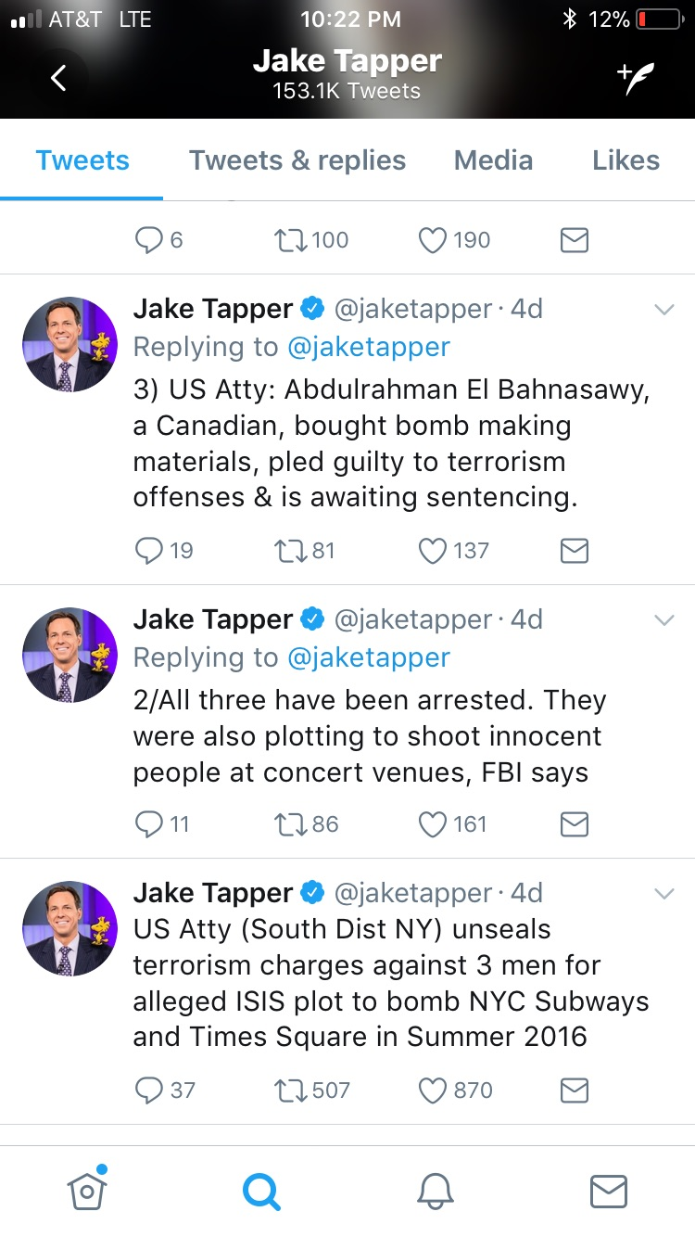
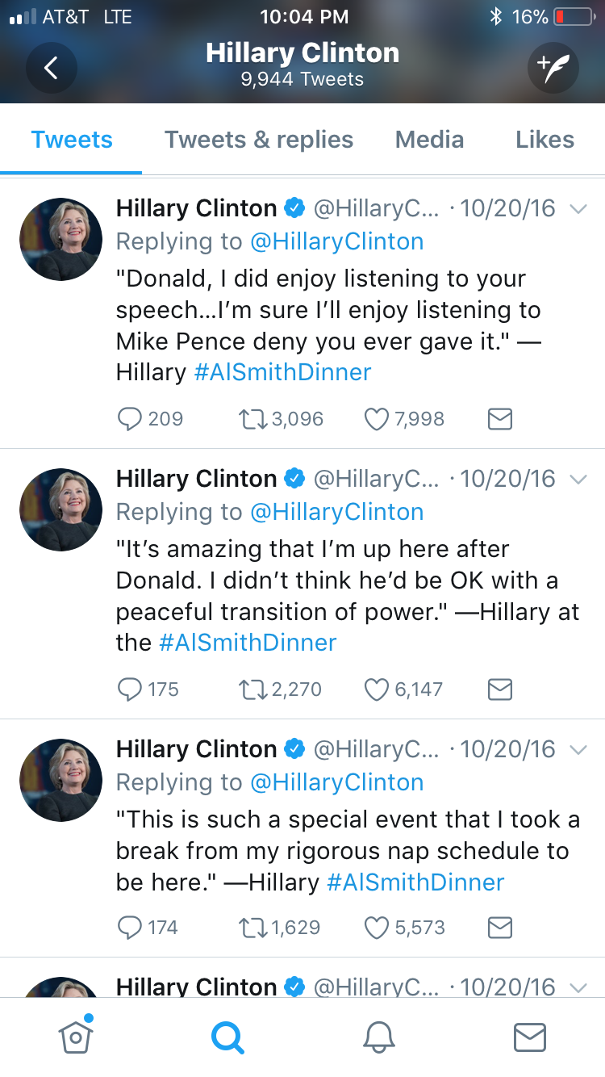
Live Tweet

Slide 11
Live Tweet Directions
During the reading:
-Make notes on your copy of the speech of what you would want to say
-Think of the angle you want to take (political columnist, celebrity, gossip columnist, average person, etc.)
After the reading:
-Create your own series of Tweets (minimum of 5 tweets, 75-140 characters per Tweet) about the speech
-If you finish before time is up, decorate your Twitter avatar
-Be creative in your tweets while maintaining accuracy of the text & historical considerations.

Slide 12
I hope you enjoyed this presentation. Thank you for the opportunity to present today.
Questions? Comments? Want to use this or see some of my other presentations?
Email: KELLEYW@scsk12.org
Website:https://teacherwillkelley.weebly.com/professional-development.html

